Slide 1


Spotify Analysis
Antonia Sunseri
Manith Kumarapeli

Slide 2

Problem Definition
Problem Definition
Research Question
Definition
Are top-hit songs becoming shorter over time, and how do musical features and versions influence a track's popularity?
Clarity and Specificity
Do these features have a measurable impact on a song's success?
Novelty And Impact
Dataset Description
Data Cleaning
Feature Engineering
Data Visualizations
Key Insights
Analysis Work
Result Interpretation

Slide 3
Research Question
Problem Definition
Research Question
Have songs of shorter durations become more popular?
Has the popularity of explicit songs increased over time in mainstream Spotify hits?
Do songs that feature other artists tend to be more popular than solo performances?
Which genres are most popular?
Novelty And Impact
Dataset Description
Data Cleaning
Feature Engineering
Data Visualizations
Key Insights
Analysis Work
Result Interpretation

Slide 4
Novelty and Real-World Impact
Problem Definition
Research Question
Novelty And Impact
Novelty
- Dives into how specific song attributes affect listener preferences.
- Offers a new, and underexplored perspective non what makes song connect with modern audiences.
Real World Impact
- Record labels may release multiple versions of the same song
- Artists may incorporate provocative terms more frequently
- Streaming platforms can optimize user recommendations
- Boost and tag multiple versions of popular songs for marketing
- Reconsider restrictions and brand safe edits
Dataset Description
Data Cleaning
Feature Engineering
Data Visualizations
Key Insights
Analysis Work
Result Interpretation

Slide 5
Dataset Description
Problem Definition
Dataset
Source: Top Hits Spotify from 2000–2019 (Kaggle)
Contains song metadata for Spotify Top Hits from 2000 to 2019 for 2,000 songs
Dataset Selection
Provides a suitable timespan (2000–2019)
Suitable for evaluating how musical attributes relate to popularity
Meta Data Utilization
- Song field: Used to detect if a track is an edited or remixed version
- Artist and Song fields: Combined to identify featuring artists
- Popularity metric: Serves a key indicator of song performance
- Explicit field: Indicates whether a song has explicit content
- Year: Enables trend analysis
Research Question
Novelty And Impact
Dataset Description
Data Cleaning
Feature Engineering
Data Visualizations
Key Insights
Analysis Work
Result Interpretation

Slide 6
Data Cleaning and Preprocessing
Problem Definition
Research Question
Cleaning:
Missing Values
Outlier Detection
Duplicate Removal
Remove data with zero popularity
Type Conversion:
Correction of Data Types
Novelty And Impact
Dataset Description
Data Cleaning
Feature Engineering
Data Visualizations
Key Insights
Analysis Work
No missing values were found in the dataset with 2,000 observations
59 duplicated columns were identified and removed
Convert years to integer, explicit to Boolean and Year to numeric
Explicit as a Boolean helps for logical filtering
Normalized casing inconsistencies
Result Interpretation

Slide 7
Feature Engineering
Problem Definition
Research Question
Novelty And Impact
Created a Boolean columns for edited or original songs.
Created columns to indicate whether there is a featuring artist.
Another to check whether there are two or more featuring artists.
Column with time divided to segments for recent and older songs.
Created a primary genre column which contained 12 genres compared to the prior 59 genres.
Dataset Description
Data Cleaning
Feature Engineering
Data Visualizations
Key Insights
Analysis Work
Result Interpretation

Slide 8
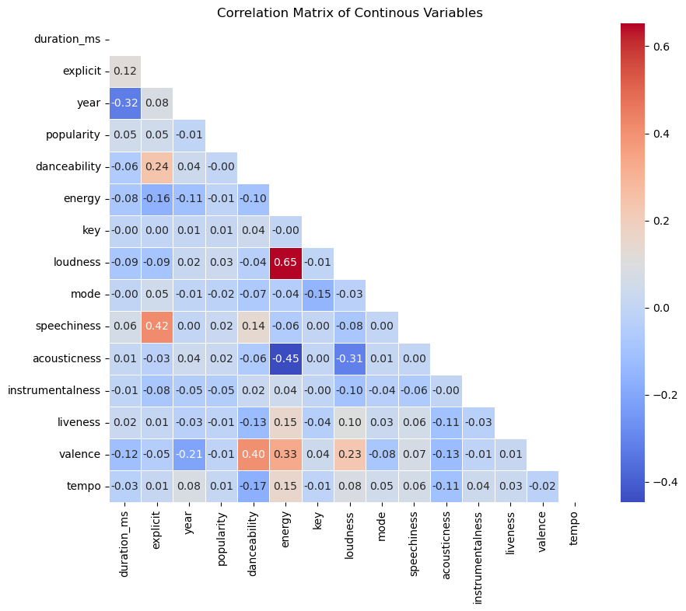
Data Visualizations
Problem Definition
Removed songs with zero popularity scoring
Loudness and energy show a severe positive correlation
Acousticness and energy show a severe negative correlation
Consider removal of energy to avoid multicollinearity in future modeling
Research Question
Novelty And Impact
Dataset Description
Data Cleaning
Feature Engineering
Data Visualizations
Key Insights
Analysis Work
Result Interpretation

Slide 9
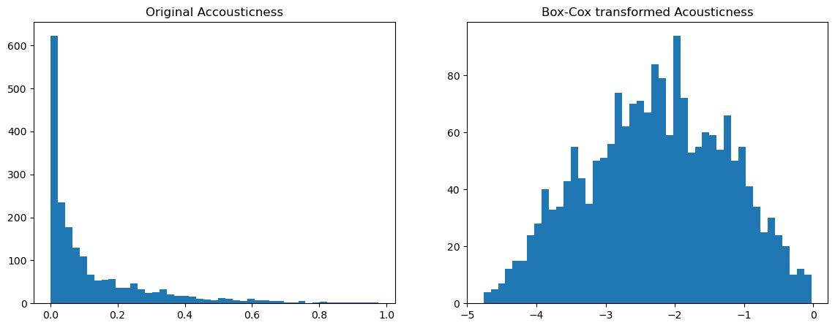
Data Visualizations
Problem Definition
Several features were heavily skewed, such as loudness, energy, and acousticness
Box-Cox transformation
Box-Cox tries to find a λ (lambda) that transforms the data to approximate a normal distribution
Some data is inherently non-normal even after transformation—especially highly-skewed distribution.
Research Question
Novelty And Impact
Dataset Description
Data Cleaning
Feature Engineering
Data Visualizations
Key Insights
Analysis Work
Result Interpretation

Slide 10
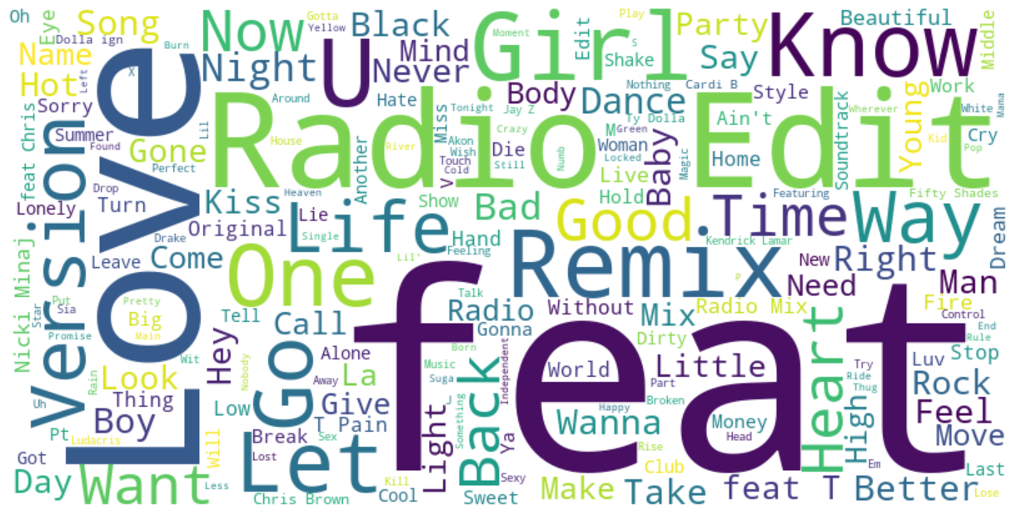
Key Insights
Problem Definition
Research Question
Novelty And Impact
Dataset Description
Data Cleaning
Feature Engineering
Data Visualizations
Key Insights
Analysis Work
Result Interpretation
Words indicating featuring artist - feat., with, Featuring, Feat., &, Vs., X
Identify an edited song - Radio, Version, Remix, Version, Mix, Remaster, (Personal), (Interlude), Explicit, Video, Edit, *, from, Official

Slide 11
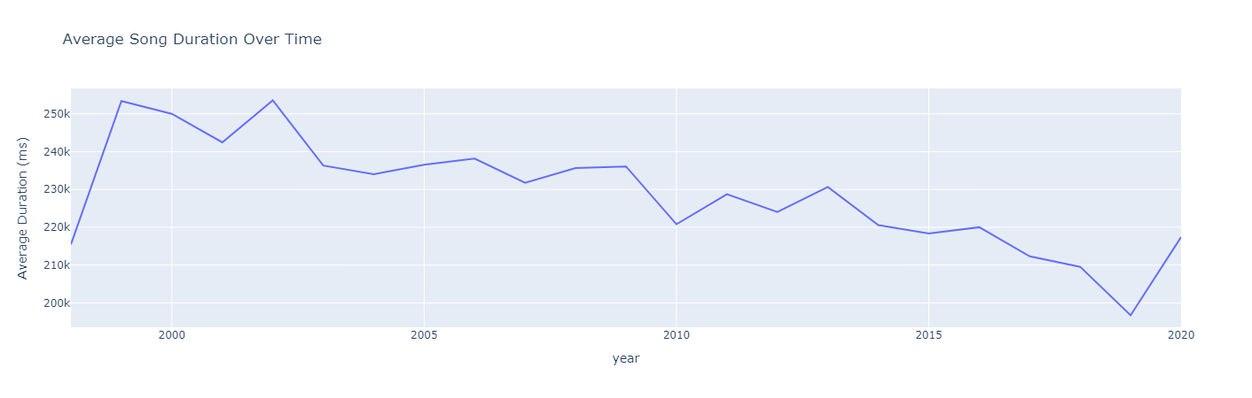
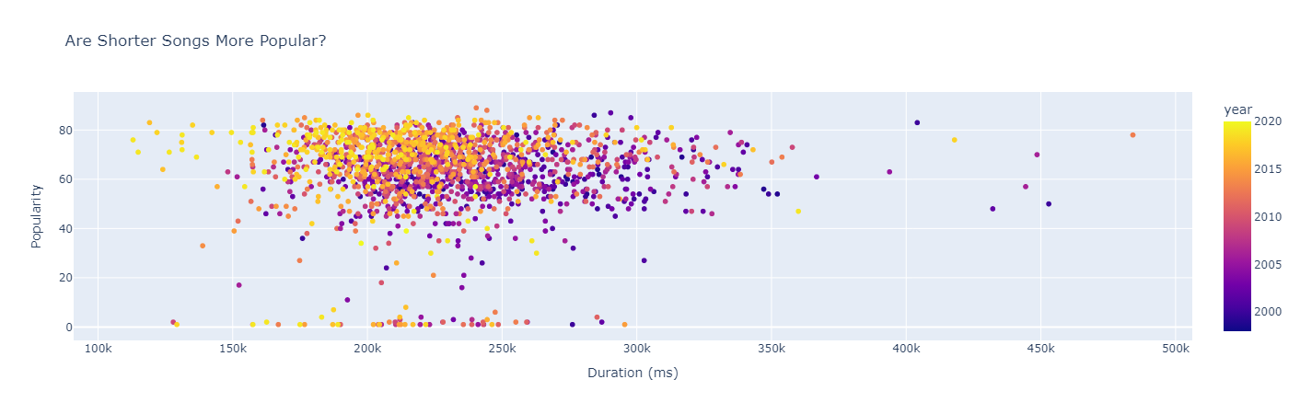
Popularity of Shorter Songs
Problem Definition
Research Question
Novelty And Impact
Dataset Description
Data Cleaning
Feature Engineering
Data Visualizations
Key Insights
Analysis Work
Result Interpretation

Slide 12
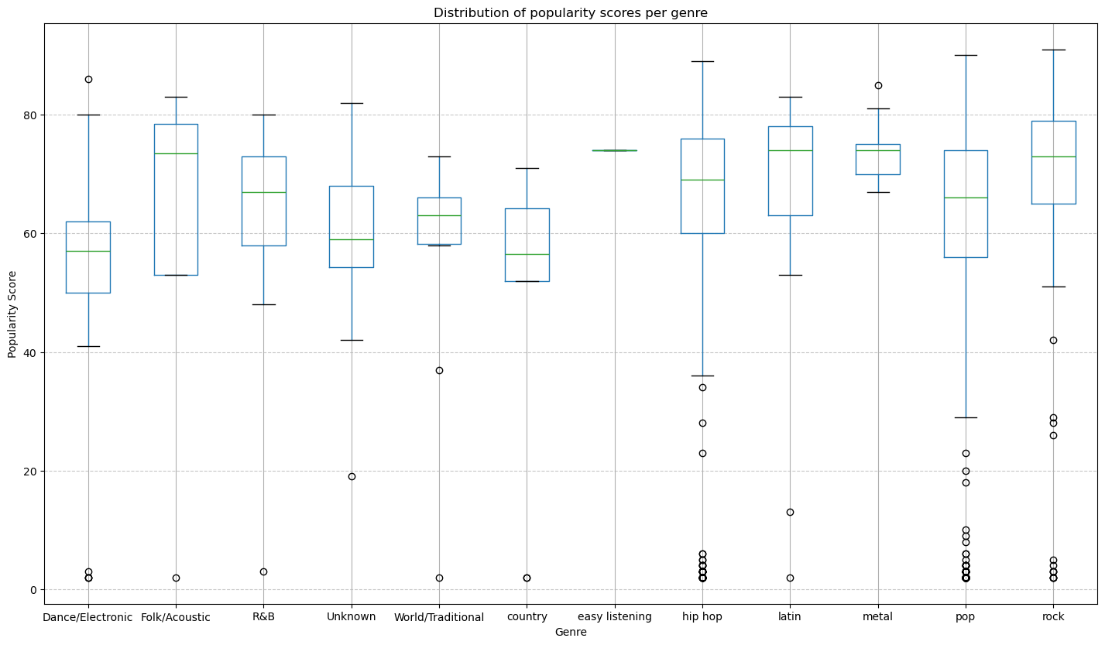
Popularity by Genre
Problem Definition
Research Question
Novelty And Impact
Dataset Description
Data Cleaning
Feature Engineering
Data Visualizations
Key Insights
Analysis Work
Result Interpretation

Slide 13
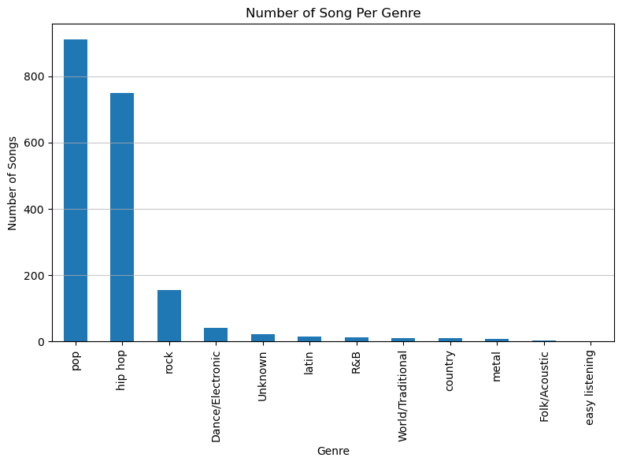
Songs Per Genre
Problem Definition
Research Question
Novelty And Impact
Dataset Description
Data Cleaning
Feature Engineering
Data Visualizations
Key Insights
Analysis Work
Result Interpretation

Slide 14
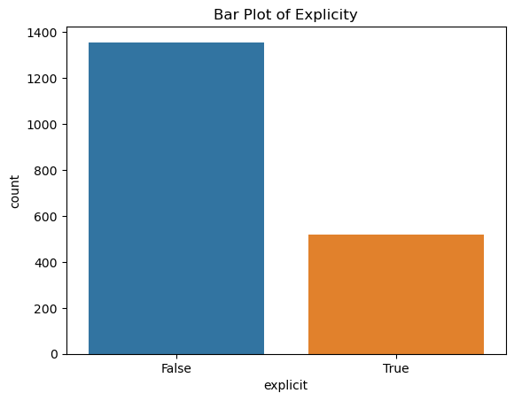
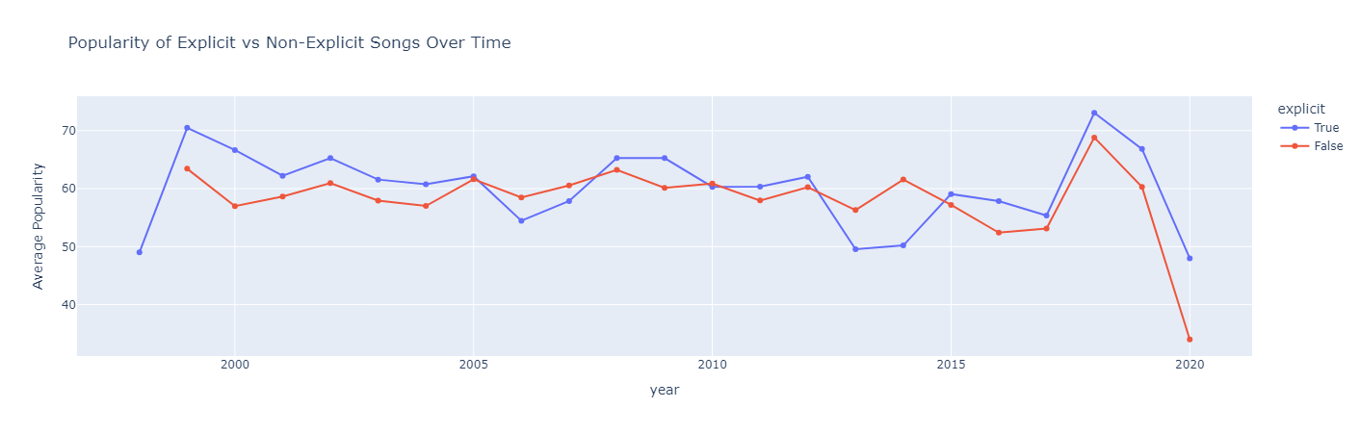
Popularity of Explicit Songs
Problem Definition
Research Question
Lower proportion of explicit versus non-explicit songs
Explicit songs on average have a slightly higher popularity scoring
Novelty And Impact
Dataset Description
Data Cleaning
Feature Engineering
Data Visualizations
Key Insights
Analysis Work
Result Interpretation

Slide 15
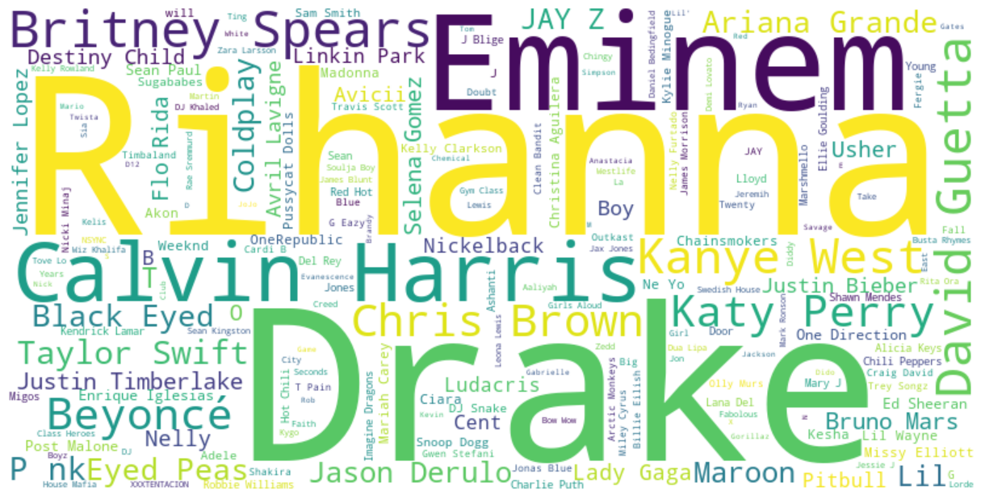
Popularity of Featuring Artists and Edited Versions
Problem Definition
Research Question
Some artists appear more commonly
Novelty And Impact
Dataset Description
Data Cleaning
Feature Engineering
Data Visualizations
Key Insights
Analysis Work
Result Interpretation

Slide 16

Problem Definition
Research Question
Analysis Work
Novelty And Impact
Dataset Description
Data Cleaning
Cleaning and Preprocessing
Correlation Analysis – Correlation Matrix
Feature Engineering – Extracting Artists
Hypothesis
Feature Engineering
Data Visualizations
Key Insights
Analysis Work
Result Interpretation

Slide 17
Results Interpretation and Hypothesis
Problem Definition
Research Question
01
The average duration of top-hit songs has decreased between 2000 to 2019, due to the influence of streaming platforms and shorter listener attention spans
Novelty And Impact
Dataset Description
Data Cleaning
02
Tracks that have one or more featured artist will have a higher popularity score compared to those without, due to increased exposure
Feature Engineering
Data Visualizations
Key Insights
03
Explicit songs have higher popularity scores, especially in more recent years, reflecting cultural changes
Analysis Work
Result Interpretation

Slide 18
Thank You!
Any Question?

